Slide 1
TOP 250 MOVIES OF ALL TIME
Data harvesting assignment using web scraping techniques and Reddit API
Alexandra Salo and Sofia Villamil

Slide 2
TABLE OF CONTENTS
01 | Introduction
02 | Methodology
04 | Challenges
05 | Results
First look at the topic we have choosen for this project
The tools we are going to use to achive our goal
Problems we have encountered
Final thoughts

Slide 3
INTRODUCTION
01
Our goal was to compile a dataset that accurately represents the top-rated movies listed in the IMDb's Top 250, ensuring it is both comprehensive and reflective of quality of the data found in this website.

Slide 4
METHODOLOGY PART 1
02
To achieve our project's objectives, we opted to utilize web scraping techniques on the IMDb page to extract the following attributes:
Score
Duration
Actors
Writer
Director
Budget
Worldwide gross
Reviews

Slide 5
METHODOLOGY PART 2
02
After extracting data from the IMDb page through web scraping, we proceeded to utilize the Reddit API to gather social media sentiment regarding these movies.
Once we obtained discussions and comments from Reddit, we conducted sentiment analysis, integrating this data with the reviews acquired during the web scraping phase for a comprehensive evaluation.

Slide 6
CHALLENGES
03
Scrapping the IMDB website
create a code that was both comprehensive and easy to understand. Thus, the main challenge was to ensure specificity in our code to account for variations in the website's layout.
Looping everything and the amount of time it took to get the variables
Scrapping the Reddit website
Getting the whole idea of the API
Once I accessed my first endpoint, the world was mine
Looping everything together was a mess, I learned to work better in chunks and test with the final input I give it

Slide 7
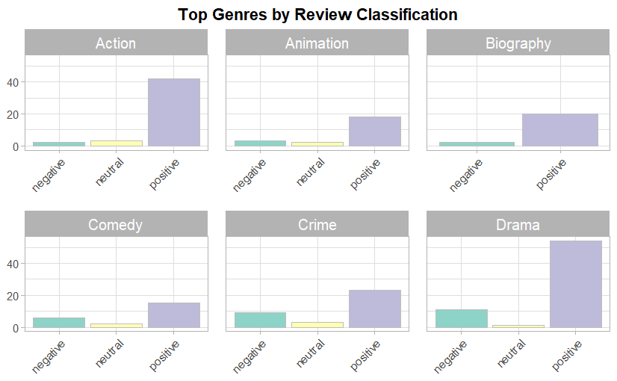
RESULTS

Slide 8
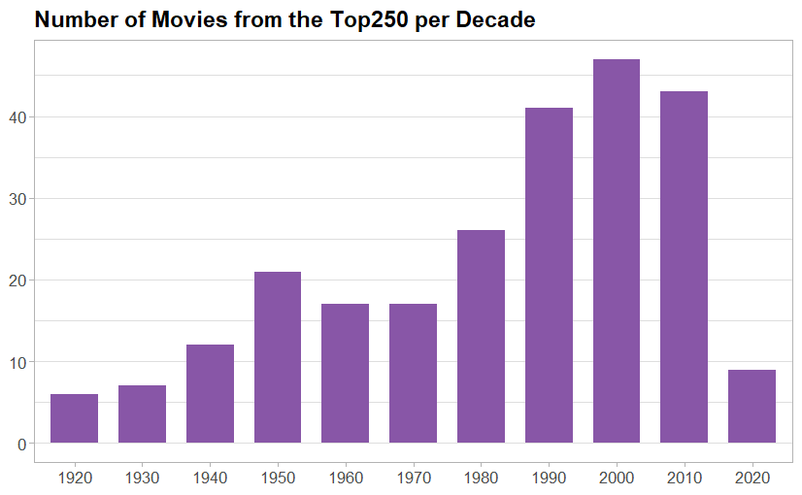
RESULTs

Slide 9
Thank you!

